Slide 1


ENHANCED CLUSTERING AND ROUTING MECHANISM FOR ENERGY EFFICIENT COMMUNICATION IN WIRELESS SENSOR NETWORKS
DEPARTMENT OF ELECTRONICS ENGINEERING
MIT CAMPUS, ANNA UNIVERSITY
PROJECT WORK I
Presented by: Under the guidance of :
SRINATH S ( 2024616026) Dr. VASIM BABU
M.E Wireless Technologies. Assistant Professor,
Dept of Electronics Engineering,
Madras Institute of Technology,
Anna University.

Slide 2

CONTENTS
Objective
Proposed Methodology
Flow Chart
Work flow
Result and Discussion
References

Slide 3
OBJECTIVE
The project aims to develop a novel, clustering algorithm and a resource-aware routing protocol.
The proposed clustering will achieve balanced workload distribution and mitigate hotspots, enhancing network lifetime.
The routing protocol aims to enable real-time adaptation with minimal re-clustering and low communication overhead.
An optimized hybrid algorithm, combining clustering and routing, will be validated through simulations and hardware testing for superior performance.

Slide 4
Clustering in WSN
Clustering organizes sensor nodes into smaller groups to manage communication efficiently.
Each cluster has a Cluster Head (CH) responsible for coordination.
Normal nodes, called Cluster Members (CMs), send their sensed data to the CH.
The CH aggregates and compresses the collected data.
Aggregated data is then transmitted from CHs to the Base Station (BS).
This approach reduces energy consumption and extends the overall network lifetime.

Slide 5
Cluster Head Selection
Direct communication of every node with BS causes high energy consumption.
Nodes far from BS die quickly due to long transmission distances.
Random CH selection may overload weak nodes and reduce network lifetime.
CH selection ensures efficient energy distribution among all nodes.
Extends network lifetime by reducing energy drain.
Maintains connectivity by preventing early node deaths.
Improves scalability for large networks.

Slide 6
PROPOSED METHODOLOGY
Hybrid ISSA+PSO
Improved Squirrel Search Algorithm(ISSA)
The Improved Squirrel Search Algorithm (ISSA) is a nature-inspired metaheuristic based on the gliding and food-searching behavior of flying squirrels.
Key mechanisms in ISSA:
Adaptive Population Initialization: generates initial solutions closer to optimal regions,
Dynamic Step Size Control: adaptively adjusts the search step to balance exploration of new solutions and exploitation of good ones.
Local Search Mechanism: refines promising solutions through neighborhood search for higher accuracy.
Seasonal Monitoring & Lévy Flight: help ISSA avoid local optima and explore globally.

Slide 7
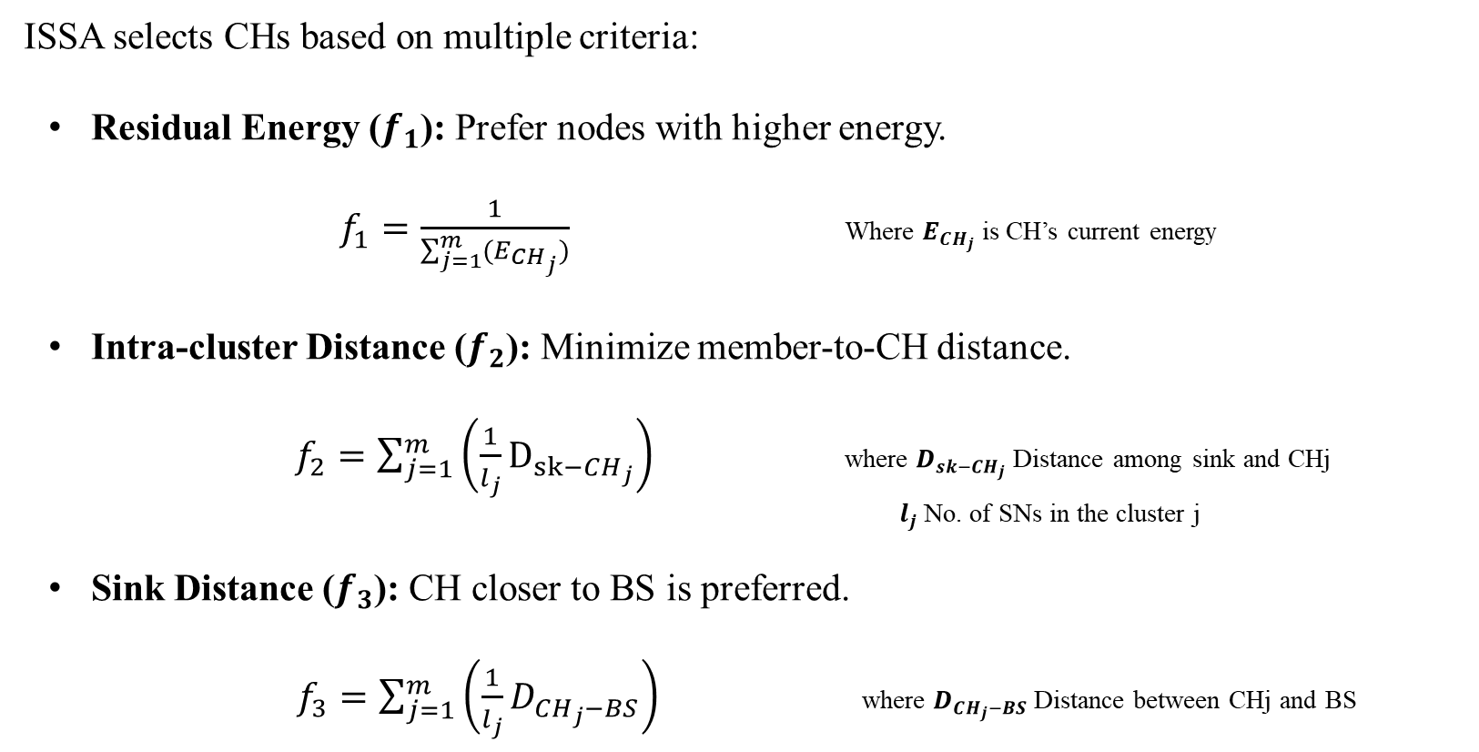
ISSA for Cluster Head Selection
ISSA selects CHs based on multiple criteria:
  Residual Energy ($f_{1}$): Prefer nodes with higher energy.
  $f_{1}=\frac{1}{\sum_{j=1}^{m}{{(E}_{CH_{j}})}}$ Where $E_{CH_{j}}$ is CH’s current energy
  Intra-cluster Distance ($f_{2}$): Minimize member-to-CH distance.
  $f_{2}=\sum_{j=1}^{m}{\left(\frac{1}{l_{j}}D_{sk−CH_{j}}\right)}$ where $D_{sk−CH_{j}}$ Distance among sink and CHj
  $l_{j}$No. of SNs in the cluster j
  Sink Distance ($f_{3}$): CH closer to BS is preferred.
  $f_{3}=\sum_{j=1}^{m}{\left(\frac{1}{l_{j}}D_{CH_{j}−BS}\right)}$ where $D_{CH_{j}−BS}$ Distance between CHj and BS

Slide 8
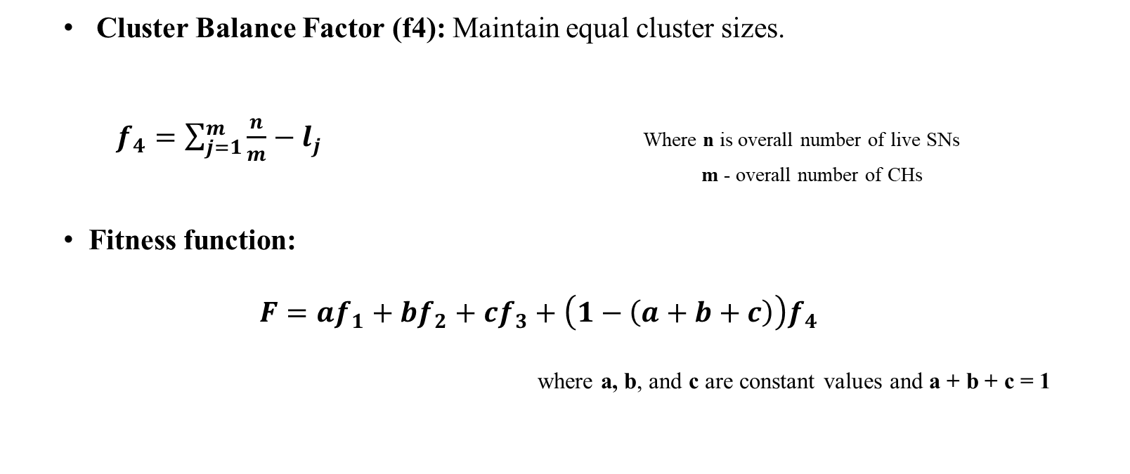
ISSA for Cluster Head Selection
  Cluster Balance Factor (f4): Maintain equal cluster sizes.
  $f_{4}=\sum_{j=1}^{m}{\left.\frac{n}{m}−l_{j}\right.}$ Where n is overall number of live SNs
  m - overall number of CHs
  Fitness function:
  $$F=af_{1}+bf_{2}+cf_{3}+\left(1−\left(a+b+c\right)\right)f_{4}$$
where a, b, and c are constant values and a + b + c = 1

Slide 9
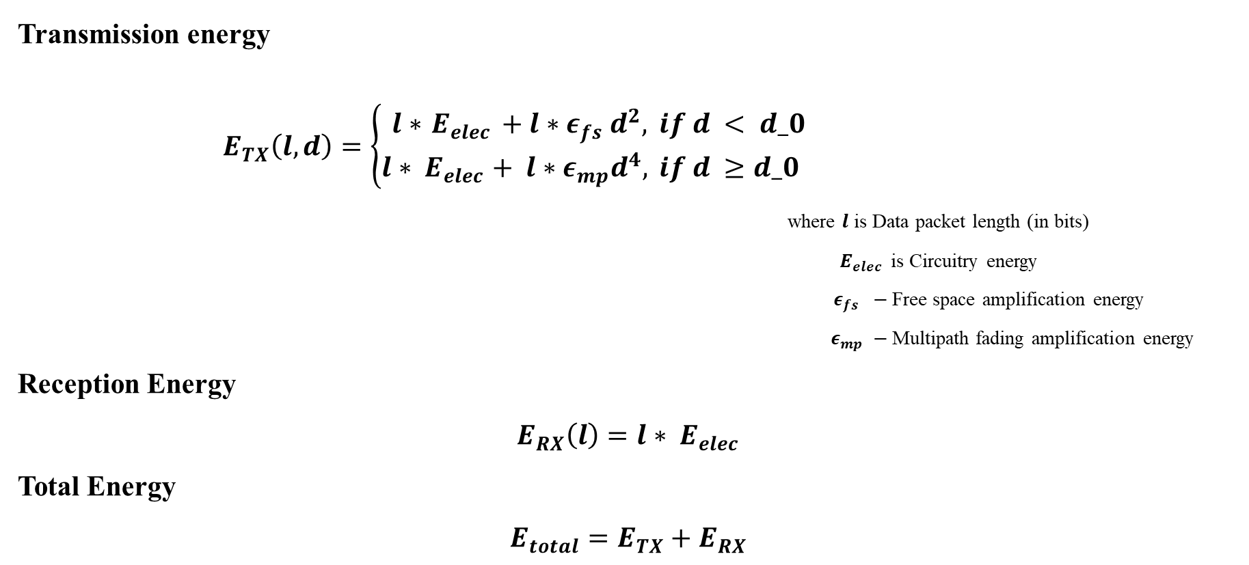
Energy model
Transmission energy
$E_{TX}\left(l,d\right)=\left\{\begin{aligned}l∗{ E}_{elec} + l∗ε_{fs} d^{2}, & if d < d_0 \\ l{ ∗ E}_{elec}+ l∗ε_{mp}d^{4}, & if d ≥d_0\end{aligned}\right.$
where $l$ is Data packet length (in bits)
${ E}_{elec}$ is Circuitry energy
$ε_{fs} −$Free space amplification energy
$ε_{mp} −$Multipath fading amplification energy
Reception Energy
$$E_{RX}\left(l\right)=l{∗ E}_{elec}$$
Total Energy
$$E_{total}=E_{TX}+E_{RX}$$

Slide 10
Particle swarm optimization algorithm
PSO is a population-based metaheuristic inspired by the social behavior of bird flocking and fish schooling.
Each potential solution is called a particle, represented by a position and velocity in a search space.
Particles move by updating their position based on:
  Their own best experience (pbest)
  The global best solution found by the swarm (gbest)

Slide 11
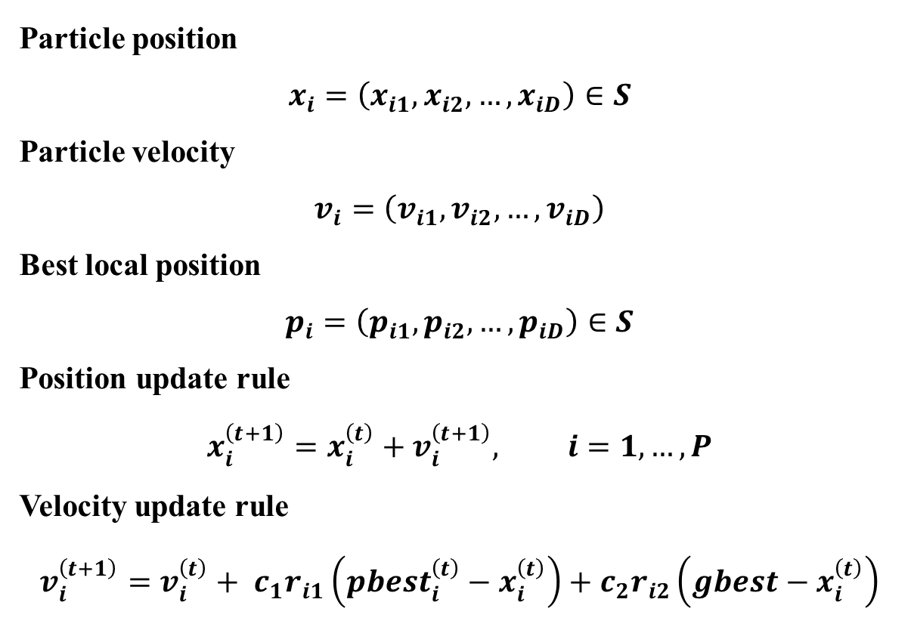
Particle swarm optimization algorithm
Particle position
$$x_{i}=\left(x_{i1},x_{i2},…,x_{iD}\right)∈S$$
Particle velocity
$$v_{i}=\left(v_{i1},v_{i2},…,v_{iD}\right)$$
Best local position
$$p_{i}=\left(p_{i1},p_{i2},…,p_{iD}\right)∈S$$
Position update rule
$$x_{i}^{\left(t+1\right)}=x_{i}^{\left(t\right)}+v_{i}^{\left(t+1\right)}, i=1,…,P$$
Velocity update rule
$$v_{i}^{\left(t+1\right)}=v_{i}^{\left(t\right)}+ c_{1}r_{i1}\left(pbest_{i}^{\left(t\right)}−x_{i}^{\left(t\right)}\right)+c_{2}r_{i2}\left(gbest−x_{i}^{\left(t\right)}\right)$$
Where
Xi | Particle ii's position vector
Vi | Particle ii's velocity vector
pi | Particle ii's personal best position
pbesti | Best-known position for particle i
gbest | Best-known position for the entire swarm
c1,c2 | Cognitive & social coefficients
ri1,ri2 | Random numbers for stochastic effect
D | Dimensionality of the problem

Slide 12
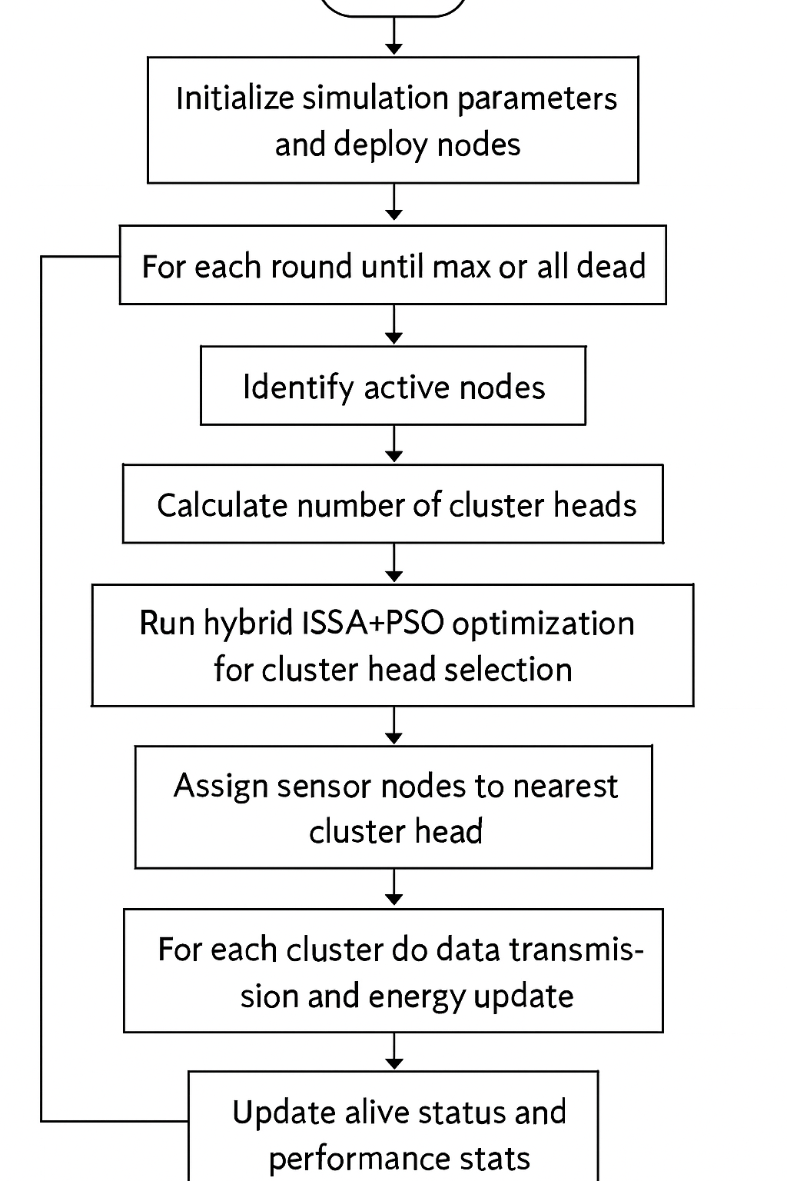
FLOW CHART
Start
Yes
No
End

Slide 13
Pseudo code of the proposed Method
Start Hybrid ISSA+PSO
1. Create random population of solutions
2. Calculate fitness of each solution
3. Save best solution of each candidate (pbest)
4. Save overall best solution (gbest)
Repeat until maximum iterations:
For each candidate:
- Move using ISSA rules (towards gbest, random reset, local search )
- Move using PSO rules (velocity + position update)
- Compare both moves, keep the better one
- Update pbest if improved
Update gbest (best among all pbests)
End Repeat
Return gbest as final best solution
End Hybrid ISSA+PSO

Slide 14
RESULT AND DISCUSSION

Slide 15
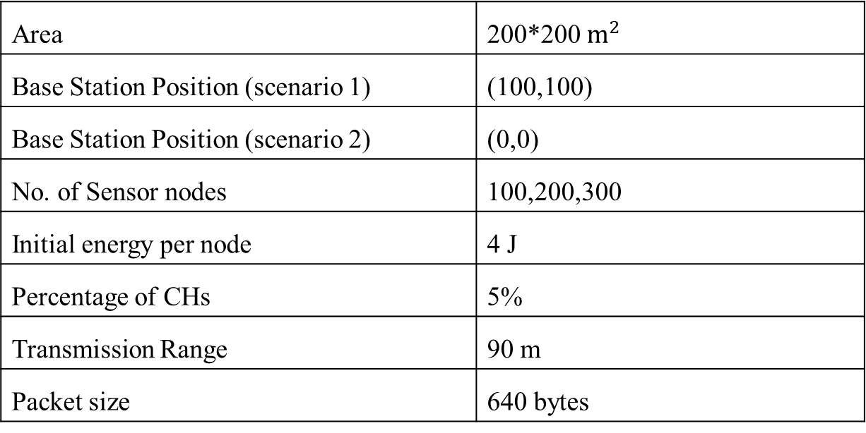
SIMULATION PARAMETERS
Area | 200*200 $m^{2}$
Base Station Position (scenario 1) | (100,100)
Base Station Position (scenario 2) | (0,0)
No. of Sensor nodes | 100,200,300
Initial energy per node | 4 J
Percentage of CHs | 5%
Transmission Range | 90 m
Packet size | 640 bytes

Slide 16
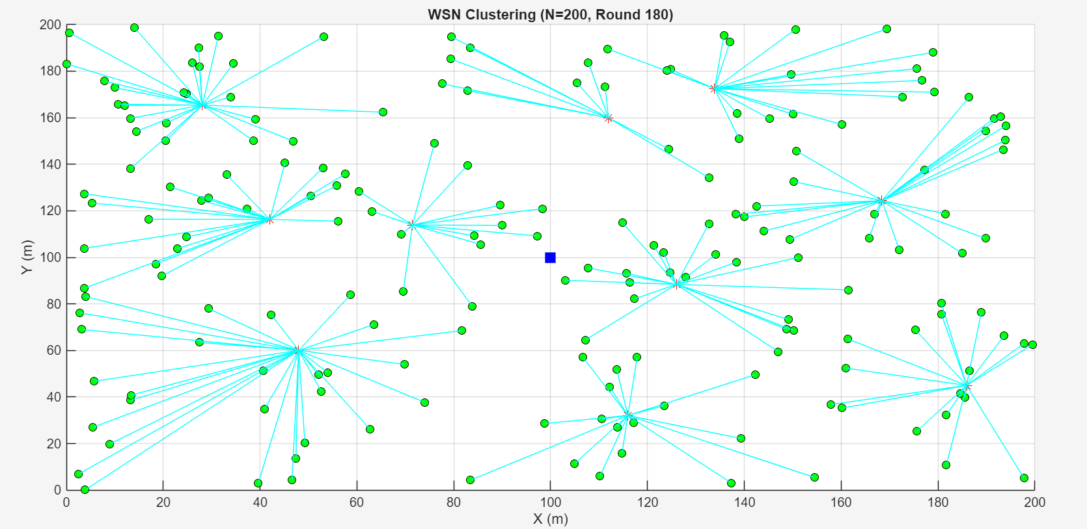
SIMULATION SETUP

Slide 17
Network Life Time

Slide 18
Network Life Time

Slide 19
Total Residual Energy

Slide 20
Total Residual Energy

Slide 21
WORK FLOW
Review | Work to be Done
Review 1 | Technical Modeling, Algorithm Development and Simulation For Clustering.
Review 2 | Algorithm Development & Simulation for Routing
Review 3 | Comparative Analysis and Hardware Testing

Slide 22
REFERENCES
[1] Alshammri, G.H. Enhancing wireless sensor network lifespan and efficiency through improved cluster head selection using improved squirrel search algorithm. Artif Intell Rev 58, 79 (2025). https://doi.org/10.1007/s10462-024-11088-4.
[2] Shafiq Alam, Gillian Dobbie. et al. Research on particle swarm optimization based clustering: A systematic review of literature and techniques, in Elsevier 2014 Swarm and Evolutionary Computation, Volume 17,Pages 1-13 https://doi.org/10.1016/j.swevo.2014.02.001
[3] Tawfeek, M.A., Alrashdi, I., Alruwaili, M. et al. Improving energy efficiency and routing reliability in wireless sensor networks using modified ant colony optimization. J Wireless Com Network 2025, 22 (2025). https://doi.org/10.1186/s13638-025-02449-w
[4] C. Wang, X. Liu, H. Hu, Y. Han and M. Yao, "Energy-Efficient and Load-Balanced Clustering Routing Protocol for Wireless Sensor Networks Using a Chaotic Genetic Algorithm," in IEEE Access, vol. 8, pp. 158082-158096, 2020. doi: 10.1109/ACCESS.2020.3020158.
[5] Roy, K.; Kim, M.-K. Applying Quantum Search Algorithm to Select Energy-Efficient Cluster Heads in Wireless Sensor Networks. Electronics 2023, 12, 63. https://doi.org/10.3390/electronics12010063

Slide 23
REFERENCES(Cntd.)
[6] D. Gupta et al., "Optimizing Cluster Head Selection for E-Commerce-Enabled Wireless Sensor Networks," in IEEE Transactions on Consumer Electronics, vol. 70, no. 1, pp. 1640-1647, Feb. 2024, doi: 10.1109/TCE.2024.3360513.
[7] M. Biradar and B. Mathapathi, ‘‘Secure, reliable and energy efficient routing in WSN: A systematic literature survey,’’ in Proc. Int. Conf. Adv. Electr., Comput., Commun. Sustain. Technol. (ICAECT), Feb. 2021, pp. 1–13, doi: 10.1109/ICAECT49130.2021.9392561
[8] M. Shafiq, H. Ashraf, A. Ullah, and S. Tahira, ‘‘Systematic literature review on energy efficient routing schemes in WSN—A survey,’’ Mobile Netw. Appl., vol. 25, no. 3, pp. 882–895, Jun. 2020.
[9] O. A. Khashan, R. Ahmad, and N. M. Khafajah, ‘‘An automated lightweight encryption scheme for secure and energy-efficient communi cation in wireless sensor networks,’’ Ad Hoc Netw., vol. 115, Apr. 2021, Art. no. 102448.
[10] S. Umbreen, D. Shehzad, N. Shafi, B. Khan, and U. Habib, “An energy efficient mobility-based cluster head selection for lifetime enhancement of wireless sensor networks,” IEEE Access, vol. 8, pp. 207779–207793, 2020, doi: 10.1109/ACCESS.2020.3038031.

Slide 24
THANK YOU

